Slide 1

E-commerce Customer churn Analysis and prediction
A Data Science Based
Business Intelligence Approach
College Name: L.D college of Engineering
Internal Guide : Prof.J.T.Patel
Presented by
Name : DHRUVI Patel

Slide 2
1
Table Contents
2
3
Introduction
Overview
Model Workflow
4
5
Technology Stack
Problem Statement and Goal
6
Dataset Overview

Slide 3
7
8
9
Data Processing
EDA Insights
Model Evaluation Metrics
10
11
Model Interface
Result
12
Power Bi Dashboard

Slide 4
13
Power Bi Insights
14
Recommendation
15
Conclusion

Slide 5
Introduction
What is Customer Churn?
Customer churn refers to the percentage of customers who stop doing business with a company over a given period. In E-commerce, this could mean customers who stop making purchases, cancel subscriptions, or become inactive.
Overview of the Churn Problem
Customer retention is a big challenge in e-commerce. While companies spend a lot to get new customers, keeping existing ones is more cost-effective. This project uses customer data and machine learning to find out why customers leave (churn) and predict who might leave. This helps businesses take action early and keep more customers.

Slide 6
Why is Churn Prediction Important in E-commerce?
Cost-effective: Acquiring new customers is more expensive than retaining existing ones.
Customer loyalty: Helps identify loyal vs. at-risk customers.
Revenue protection: Churn prediction allows businesses to take proactive steps to reduce revenue loss.
Targeted marketing: Enables personalized offers and retention strategies for customers likely to churn.

Slide 7
Overview
Objective
Analyze customer behavior
Build predictive model for churn
Create visual insights using Power BI
Deploy solution using Streamlit
Agenda
01
Data Collection and Preprocessing
02
Exploratory Data Analysis (EDA)
03
Model Development and Evaluation
04
Business Recommendation

Slide 8
Churn Control : A Data-Driven Retention Strategy
👥
Company needs to prevent customers from reducing their purchases of products and services
🤝
Discussing about various ways through which firm can manage the customer churn
👤
Discussing about churn propensity model
🛠️
Implementing predictive insights to take proactive retention actions

Slide 9
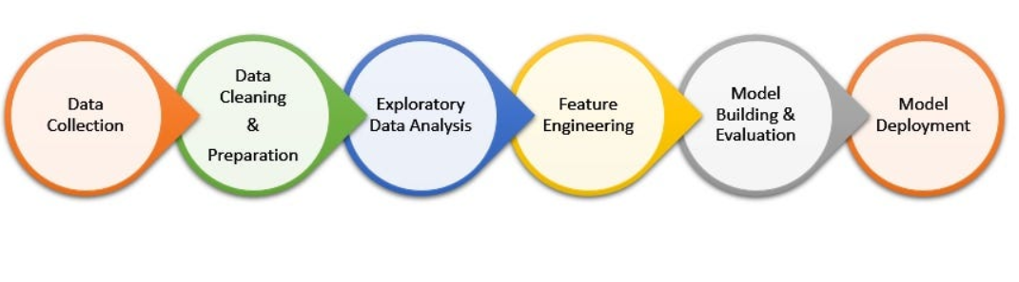
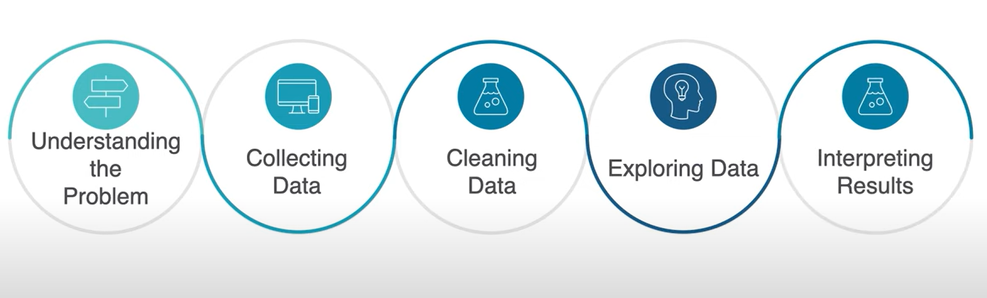
Churn Classification Model Workflow
Problem Definition – Understand the business problem and goals.
Data Collection – Gather data from various sources.
Data Cleaning – Remove errors, handle missing values, and prepare data.
Exploratory Data Analysis (EDA) – Analyze patterns and trends using stats and visuals.
Feature Engineering – Create and transform features to improve model performance.
Modeling – Build and train predictive models if needed.
Deployment – Implement models into real-world applications

Slide 10
Technology Stack
Data Analysis: Python, Pandas, NumPy
Modeling: scikit-learn, Random Forest, Decision Tree
Visualization: Matplotlib, Seaborn, Power BI
Deployment: Streamlit
Feature Engineering: Label Encoding
Model storage: Pickle/Joblib
Model Evaluation Metrics : Accuracy, precision, recall, F1-score, ROC-AUC

Slide 11
Problem Statement
Customer retention is more cost-effective than acquiring new customers.
Many companies lack tools to predict churn in advance.
There's a need for a predictive model to identify at-risk customers.
Early prediction enables proactive retention strategies and improves business performance.
E-commerce companies face high customer churn rates.
Goal
Predict customer churn using machine learning models.
Segment customers for targeted marketing strategies.
Provide insights through dashboards for better decision-making.
To analyze the behavior and attributes of customers in an e-commerce platform.
To identify the key factors contributing to customer churn.
To build and evaluate a machine learning model to predict whether a customer will churn.

Slide 12
Dataset Overview
Dataset Overview | Details
Total Rows | 5,630
Total Columns | 20
Missing Values Found In | Tenure, Warehouse To Home, HourSpendOnApp, OrderAmountHikeFromlastYear, Coupon Used, Order Count, DaySinceLastOrder
Data Types | Numeric, Categorical, float
Total Missing Values | 1,856

Slide 13
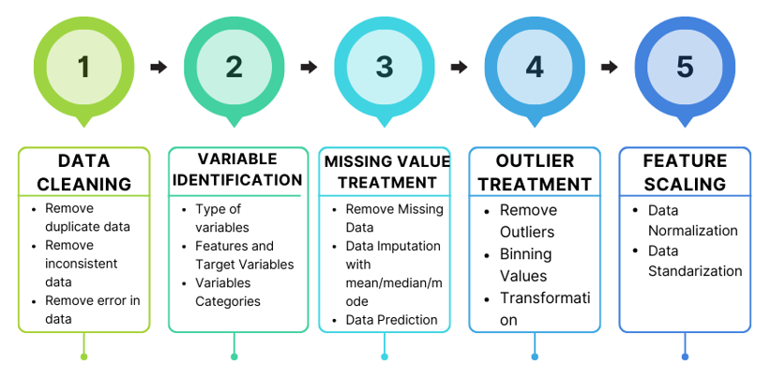
Data Processing
Handling missing values
Label/categorical encoding
Feature scaling
Train-test split
Objective
Transform and encode data for machine learning compatibility

Slide 14
1.Handling missing value
Mean, Median, and Mode Imputation
Mean Imputation is used for numerical columns that are normally distributed.
Median Imputation is more robust and is used when data has outliers.
Mode Imputation is used for categorical or discrete variables.
Encoding Categorical Variables Applied Label Encoding
3.Outlier Handling
Used IQR method or z-score to detect and treat outliers also remove outlier in Feature.
4.Splitting Data
Divided into Training Set (80%) and Test Set (20%)
5. Target Variable
Churn – Indicates whether the customer has churned (binary classification)
Description: Indicates if a customer has churned
1 = Churned
0 = Retained

Slide 15
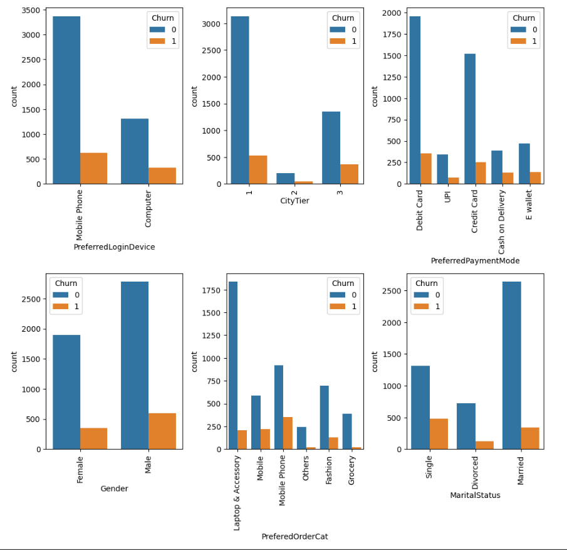
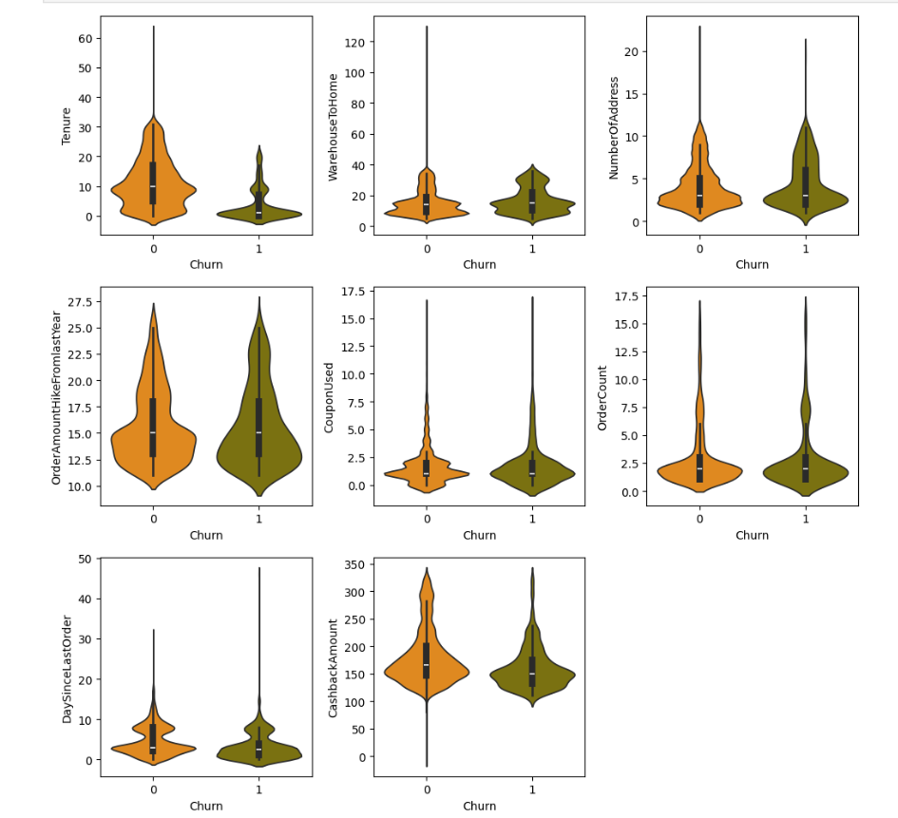
EDA INSIGHTS
Fig 1.2:Violin Plot Analysis Distribution of Key Features by Churn Status
Fig 1.1 : Churn Distribution Across Categorical Features

Slide 16
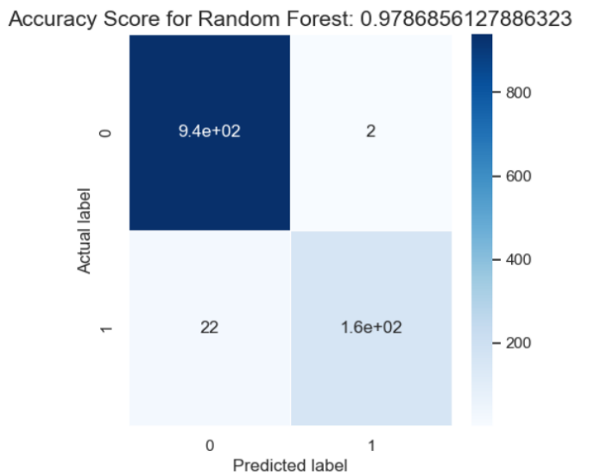
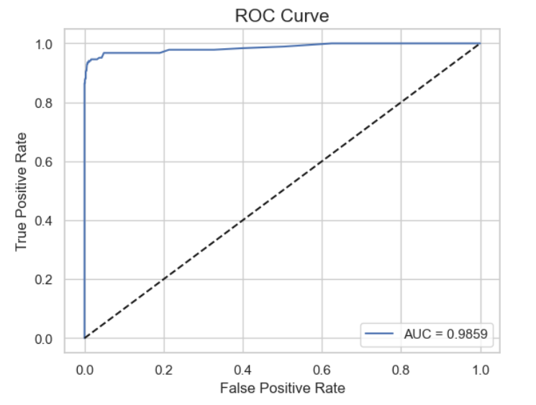
Model Evaluation Metrics
Model Used: Random Forest Classifier
Trained on processed churn dataset
Deployed using Streamlit Web App
Known for handling large datasets and preventing overfitting
Metric | Value
F1-Score | 97.87%
Precision | 97.86%
Recall | 97.85%
Log loss | 76.82%
ROC-AUC | 0.9859
Conclusion :
Random Forest was chosen due to its high accuracy and ability to handle non-linear relationships. The model helps in targeting at-risk customers with personalized retention strategies.

Slide 17
Streamlit-Based Churn Prediction Interface
Built an easy-to-use web app using Streamlit.
Takes inputs like gender, login devices, payment method, order count, satisfaction score, returns, etc.
Uses a trained Random Forest model to predict churn or not churn.
Shows results as “Churn” or “Not Churn”.
Helps businesses take quick action on at-risk customers.

Slide 18
Result
“Tenure” : 4 , “Preferred Login Device” : Mobile Phone, City Tier : 3, “WarehouseToHome”: 6 “PreferredPaymentMode” : Debit card, “Gender “: Female , “HourSpendonApp“: 3, “Number of Device Registered“: 3 , “PreferedOrderCat” : Laptop Accessory, “Satisfaction Score” : 2, “Marital Status” : Single, “Number of Address”: 9, “Complain” : 1 ,”Order Amount Hike From last Year” :11, “CouponUsed”:1 ,”Order Count “:1, “DaySinceLastOrder”:5 and “Cashback Amount “: 160.

Slide 19
“Tenure” : 4 , “Preferred Login Device” : Mobile Phone, City Tier : 3, “WarehouseToHome”: 6 “PreferredPaymentMode” : Debit card, “Gender “: Female , “HourSpendonApp“: 3, “Number of Device Registered“: 3 , “PreferedOrderCat” : Laptop Accessory, “Satisfaction Score” : 2, “Marital Status” : Single, “Number of Address”: 9, “Complain” : 1 ,”Order Amount Hike From last Year” :11, “CouponUsed”:1 ,”Order Count “:1, “DaySinceLastOrder”:5 and “Cashback Amount “: 160.

Slide 20
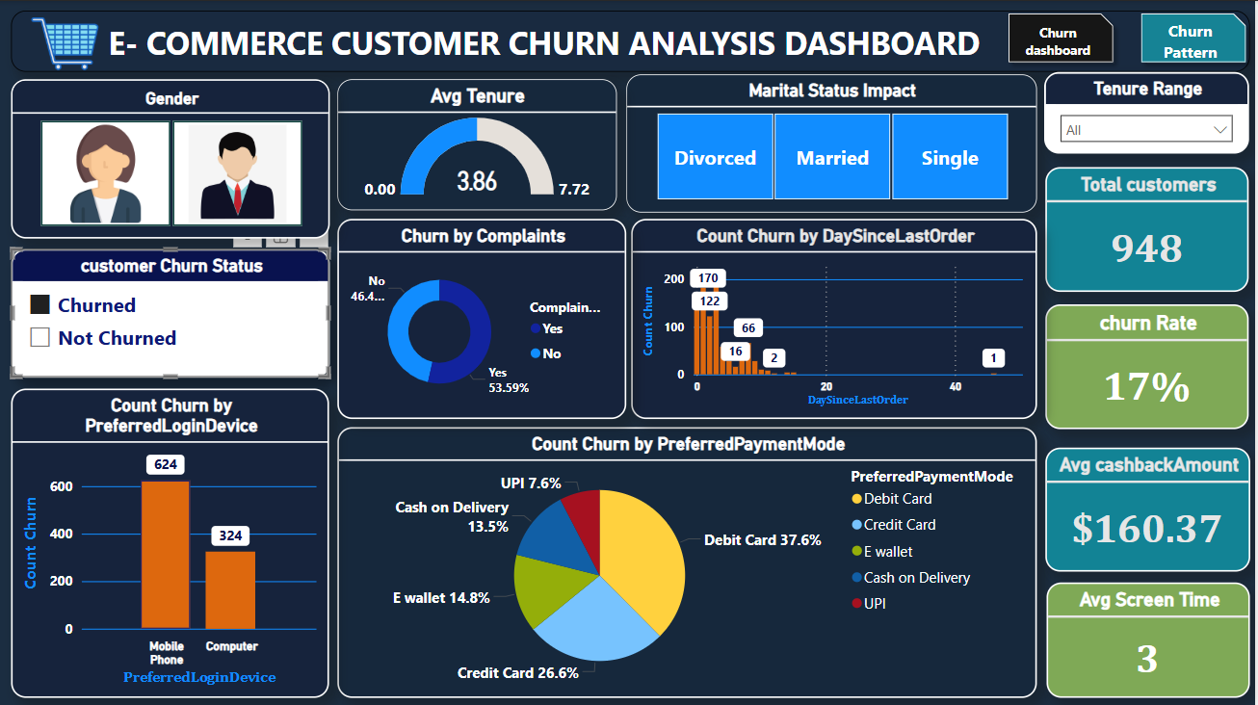
Power Bi Dashboard

Slide 21
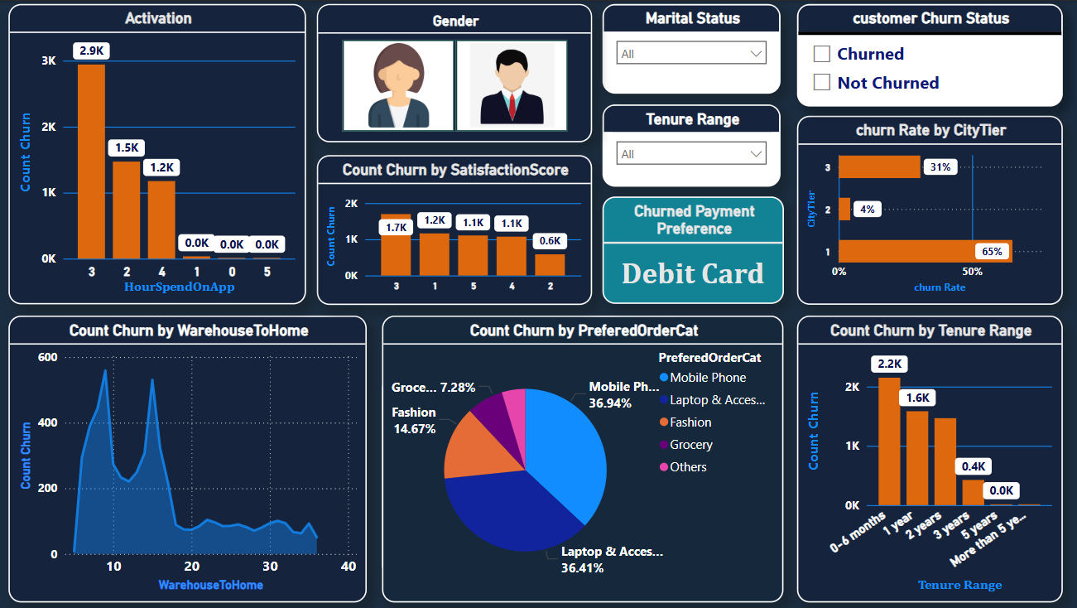

Slide 22
Power Bi Insights
The dataset includes 5,630 customers and The overall churn rate is 16.8%, indicating a significant portion of customers disengaging with the platform.
Cash on delivery has the highest churn rate, suggesting a need to enhance the experience for customers using this method. Also, E-wallet and UPI users also show relatively high churn rates, signaling potential issues with the payment process or overall satisfaction.
Customers using computers for log-in show a higher churn rate compared to those using phones .
Customers with a tenure of 0–6 months show a higher churn rate , indicating a challenge in retaining customers during the initial phases. As the tenure increases, the churn rate consistently decreases, reaching 0.0% for customers with more than 2 years association.
Tier 3 cities have the highest churn rate, indicating potential challenges or dissatisfaction specific to these regions. Also, Tier 1 and Tier 2 cities also experience notable churn rates, requiring targeted strategies for each tier.

Slide 23
Customers with 6 registered devices have the highest churn rate , possibly due to complex user experiences or account management challenges, while users with fewer registered devices show relatively lower churn rates.
Customers with moderate and far distances have higher churn rates, indicating potential issues with delivery services.
Churn rates increase with lower satisfactory scores, emphasizing the importance of customer satisfaction.
Mobile and fashion categories show higher churn rates, signaling potential issues or competition in these segments. Focusing on enhancing the user experience in these categories may help retain customers.

Slide 24
Recommendation
1. Improve the Cash on Delivery experience by streamlining the process. Investigate issues with E-wallet and UPI payments to enhance overall satisfaction and trust in the payment system.
2. Optimize the user experience for computer users, ensuring a seamless and user-friendly shopping experience. Also, consider offering exclusive promotions or features for computer users to boost engagement.
3. Focus on strategies and for customers in the 0–6 months tenure range. Implement loyalty programs and exclusive perks to encourage long-term association. Acknowledge and reward customer loyalty for those exceeding 2 years.
4.Develop targeted strategies for Tier 3 cities to address specific challenges or concerns. Tailor marketing and service offerings based on the unique characteristics of each tier. Regularly assess and adapt strategies to reduce churn in Tier 1 and Tier 2 cities.

Slide 25
5. Simplify user experiences for customers with 6 registered devices. Provide clear instructions for account management and consider streamlining features.
6. Optimize delivery services in moderate and far-distance areas. Address potential issues causing higher churn rates, such as delivery times, tracking accuracy, or customer communication. Consider partnerships or improvements to expedite deliveries.
7. Invest in improving user experiences in the mobile and fashion categories. Identify and resolve issues related to product quality and pricing. Implement marketing strategies to highlight unique selling points and capture customer interest in these categories.

Slide 26
Thank you !!

